Slide 1
Capability Statements and NAICS Codes for HBCU Contracting
A Webinar for Historically Black Colleges and Universities

Slide 2
Webinar Agenda
Introduction to the NIH
What is a Capability Statement?
Understand the Agency
Know the Team
Capability Statement Contents
Understanding NAICS Codes
Top NIH NAICS Codes
Capability Statement Format
Customize the Document
Capability Statement Tips
© 2019 Phenomenal Management Partners
Notes:
Here are the topics that will be discussed in this workshop.

Slide 3
How to Conduct Business with The National Institutes of Health (NIH)
Annette Owens-Scarboro
Office of Acquisition & Logistics Management
Program Manager, NIH Small Business Program Office

Slide 4
NIH Mission
The world’s foremost center for biomedical and behavioral science research, and the foundation that supports U.S. efforts to fight disease
The NIH mission is to discover knowledge that will lead to better health for everyone
NIH FY 2019 Budget: $39.2+ Billion

Slide 5
Institute and Centers (IC’s) and Offices of Acquisition (OA)
27 separate Institutes and Centers
10 separate Offices of Acquisitions (OA) support the IC’s by performing negotiated contracting and simplified acquisitions
https://oamp.od.nih.gov/acquisition-offices

Slide 6
NIH Institutes and Centers

Slide 7
FY2018 Solar Chart
National Institute on Drug Abuse (NIDA, NIINDS, NIMH, NIA, NCATS)
R&D $151M & Non-R&D $403M
Total: $555M
Christopher Belt
National Heart, Lung, & Blood Institute
(NHLBI, NIAMS, CSR, NIDCR, NIBIB, NHGRI)
R&D $123 & Non-R&D $165M
Total: $289M
John Taylor
National Institute of Allergy & Infectious Diseases
(NIAID, HHS Biodefense)
R&D $514M & Non-R&D $280M
Total: $794M
Charles Grewe
National Cancer Institute
(NCI, NCCIH)
R&D $870M & Non-R&D $277M
Total: $1.15B
Teresa Baughman
NATIONAL INSTITUTES OF HEALTH
OFFICE OF ACQUISITION & LOGISTICS MANAGEMENT (OALM)
Diane J. Frasier
Head of the Contracting Activity, NIH
Total: $5.528B
COAC:
R&D Contracts: $1.892B
Non-R&D Contracts: $3.203B
DELEGATED:
Purchase Card: $253M
Delegated Community: $143M
BPA CALLS: $37M
Office of Research Facilities (ORF)
All NIH Facilities Related Acquisitions
R&D $18M & Non-R&D $430M
Total: $448M
Kala Shankar
Clinical Center (CC)
R&D $.351M & Non-R&D $164M
Total: $165M
Susan Nsangou
National Institute of Environmental Health Sciences (NIEHS)
R&D $89M & Non-R&D $62M
Total: $151M
Charles Conrad / Melissa Gentry
National Library of Medicine
(NLM, CIT, OD)
R&D $19M & Non-R&D $568M
Total: $587M
Dan Hartinger
Office of Logistics & Acquisition Operations
(OLAO, NINR, NEI, ORS,
NIDCD, NIGMS, OD, NITAAC)
R&D $16M & Non-R&D $444M
Total: $460M
Acting - Susan Cortes-Shrank
NITAAC: $272M
Bridget Gauer
National Institute of Child Health and Human Development
(NICHD, NIAAA, FIC, NIDDK, NIMHD)
R&D $81M & Non-R&D $146M
Total: $227M
Olga Acosta

Slide 8
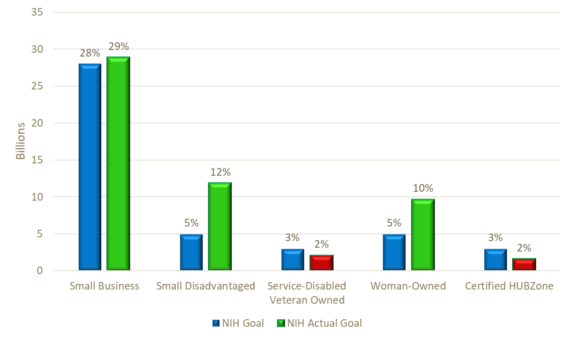
NIH FY 2018 Small Business Goals
Percentages are based on the number of eligible obligations, per small business goal, divided against the eligible total small business obligations for NIH in FY 2018. Data derived from the FPDS-NG Small Business Goaling Report. *NIH does not have a Veteran-Owned Small Business goal as it is inclusive to the Small Business goal nor does NIH have an 8(a) goal as it is inclusive to the Small Disadvantaged goal.

Slide 9
NIH FY 2019 Small Business Goals

Slide 10
What NIH Buys
PRODUCTS:
Supplies, textile goods, office furniture, chemicals, paper products, machinery, office machines, computer equipment, laboratory equipment, instrumentation and communication equipment
INFORMATION TECHNOLOGY:
IT products, management services, data entry, training, software development, maintenance, and analysis
CONSTRUCTION SERVICES:
Architectural and engineering services, construction of dwellings, office buildings, laboratories and medical facilities, renovations and alterations

Slide 11
What NIH Buys
SERVICES:
Consulting, studies, conferences, training, planning, technical assistance, clearinghouse, survey, data collection/ analysis, logistical and management support, evaluations, biomedical research and public awareness programs.
RESEARCH AND DEVELOPMENT:
Includes clinical trials, pharmacological studies, genetics and biology investigations, vaccine development and testing, and environmental research. Most of the contract obligations stem from this.

Slide 12
Research and Development (R&D) Acquisitions
Most of NIH’s R&D acquisitions are for services
Products used in labs for on-campus intramural research are also procured
Products include centrifuges, spectrometers, incubators, microscopes, sterilizers, sequences, etc.
Most R&D services are conducted at extramural universities, hospitals and private labs
Services include studies, clinical trials, testing, evaluating of diseases, medicines, etc.
Most R&D project entail several years of research (beyond 5 years) and multi-million dollar projects

Slide 13
The Path to Excellence and Innovation
The Path to Excellence and Innovation is a comprehensive plan to expand the existing National Institutes of Health (NIH) Small Business Program in the Office of Acquisition and Logistics Management (OALM).
The NIH Small Business Program is developing an HBCU Portal for Acquisition and Grants (HPAG) to provide technical assistance and training for Historically Black Colleges and Universities (HBCUs).
The HPAG will support HBCUs and prepare them to compete and receive more Federal acquisition funding that will diversify the revenues for the universities and create more business/research opportunities.
Currently there are six pilot schools and each school has chosen one or more Minority Business Enterprise (MBE) teaming partners to support their efforts in this pilot program.

Slide 14
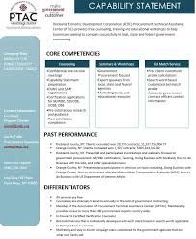
What is a Capability Statement?
It’s Your Contracting Resume
© 2019 Phenomenal Management Partners
Notes:
A Capability Statement is an important element in marketing and promoting your HBCU to the NIH and other government agencies.
To be competitive in government contracting, you must know how to:
Condense the information that is most important to a particular decision-maker,
State it in a clear, concise manner, and
Reinforce its importance to the prospect, even more so than in the past.
A Capability Statement is a tool that will help you do just that because it is a snapshot of your company that serves as a resume for your business.
Capability statements are used to compare you with other vendors. Many government agencies require that a Capabilities Statement be submitted with bids. Additionally, prime contractors may require potential subcontractors to submit capabilities statements before doing business with them. ¨
There are three standard types of capabilities statements:
A one page document used to open doors and make introductions.
A brochure that could be a part of a literature kit
And a detailed presentation used for capabilities briefings.
I’m going to focus on the one-page document.

Slide 15
A Capability Statement is NOT
A White Paper
The History of Your School
Everything You Can Do
© 2019 Phenomenal Management Partners
Notes:
This slide is pretty much self explanatory. But it is important to emphasize. If an agency asks you for a capability statement, don’t send them a white paper, the history of your institution, or a dissertation on everything the university can do.

Slide 16
Why Are They Important?
Capability Statements explain who you are, as well as what goods and services you sell.
© 2019 Phenomenal Management Partners
Notes:
A Capabilities Statement's primary purpose is for marketing. ¨ The information in Capabilities Statements can be valuable when used in brochures, websites, and other promotional literature. ¨ When you add information about awards, certifications, and clients, the Capabilities Statement can:
Create a sense of trust.
Show the maturity of your facility.
Some university officials make the mistake of saying that they are capable of doing whatever a government agency needs or wants. That simply is not true, and in making such a claim, the university loses credibility, as well as the opportunity to promote what it truly does best.
Let me give you an example.
So a Hampton capability statement would leverage this, IF that is the capability they are seeking to sell.

Slide 17
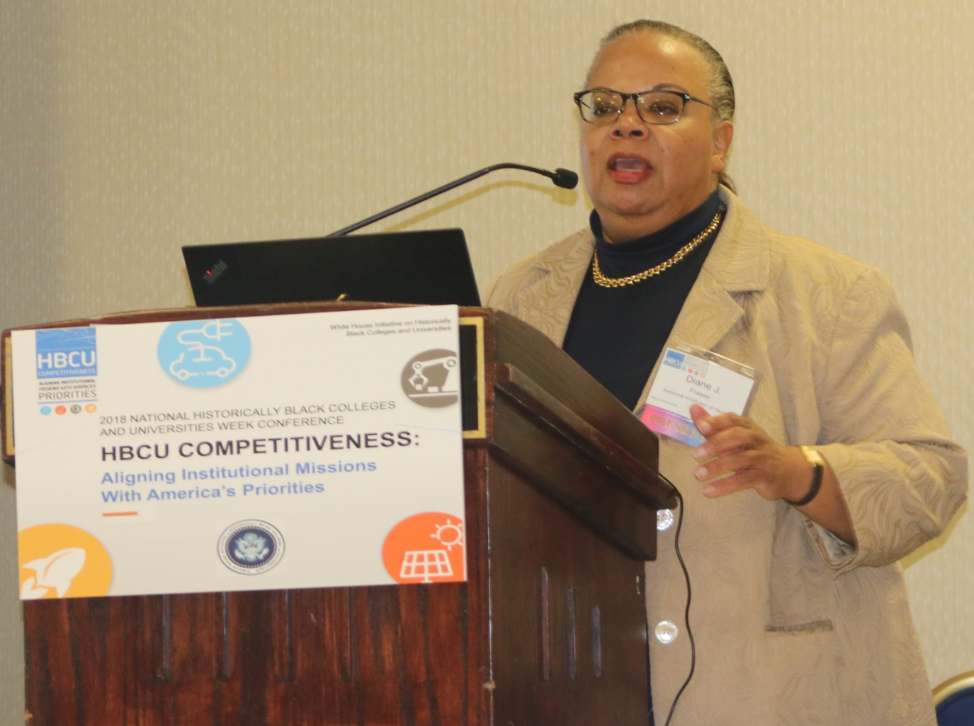
Understand the Agency
During the 2018 HBCU Week activities sponsored by the White House Initiative on HBCUs, Diane Frasier, who heads contracting activity at the National Institutes of Health, gave an overview of the agency’s plan to increase biomedical research contracts with Historically Black Colleges and Universities.
© 2019 Phenomenal Management Partners
Notes:
Presenter: For more than a century, Historically Black Colleges and Universities (HBCUs) have conducted research, implemented programs and provided advocacy on a range of issues relevant to the health and wellbeing of all people, but especially underserved communities.
O n February 28, 2017, the President of the United States of America issued Executive Order (EO) 13779: The White House Initiative to Promote Excellence and Innovation at Historically Black Colleges and Universities. This EO encourages federal agencies to assist in strengthening Historically Black Colleges and Universities’ (HBCUs) ability to equitably participate in federal programs, explore new ways to improve the relationship between the federal government and HBCUs and establish how each respective agency intends to increase the capacity of HBCUs to compete effectively for grants, contracts, and cooperative agreements. In accordance with this EO, the National Institutes of Health Office of Acquisition and Logistics Management (OALM) announced the formation of the Path to Excellence and Innovation (PEI) Program. The PEI is a program specific to HBCUs that have biomedical research capabilities, but lack grant and acquisition expertise. Through technical assistance and training, the PEI will equip HBCU participants to successfully compete for federal procurements
This is why we are here, to make sure that the University of the Virgin Islands is not just aware of the opportunity to generate revenue through contracts with the National Institutes of Health, but to take full advantage and participate.

Slide 18
Best Practices: Know the Team
Best practices clearly indicate that the most critical phase of the obtaining government contracts is the planning phase.
Members of an Acquisition Team
Contracting Officer (CO)
Contract Specialist
Contracting Officer Representative (COR)
Budget Officer
Administrative Officer
Legal
Program Director
Small Business Specialist
© 2019 Phenomenal Management Partners
Notes:
It is key to build relationships with the agency before a requirement is made public.
It will benefit you to know each person’s role and responsibility within the acquisition process. And, it is important to accurately and thoroughly define your capabilities early and communicate them to all the players throughout the entire acquisition process.

Slide 19
NIH Small Business Specialists
https://oamp.od.nih.gov/NIHSmallBusiness
© 2019 Phenomenal Management Partners
Notes:
Here is contact information for the NIH small business specialists. They will be an important resource for you in building the necessary relationships for pursuing contracts.

Slide 20
Capability Statement Contents
Core competencies
Corporate data
Differentiators
Past performance
Contact Information
© 2019 Phenomenal Management Partners
Notes:
There are five key elements that government buyers are looking for so that they can make a speedy decision.
Include the following information in your Capabilities Statement:
Core competencies.
Corporate data.
Differentiators.
Past performance.
Contact Information.

Slide 21
Core Competencies
Computer System Design Services
Administrative Management and Consulting
R&D in Biotechnology
© 2019 Phenomenal Management Partners
Notes:
Introduce your university’s core competencies and relate them to the agency’s specific needs.
To reiterate, core competencies should be short statements. They should match the agency's specific needs followed by key-word heavy bullet points. This is NOT everything a university is able to do, but the core expertise specifically related to the agency this Capability Statement is written for, its mission and identified opportunities.

Slide 22
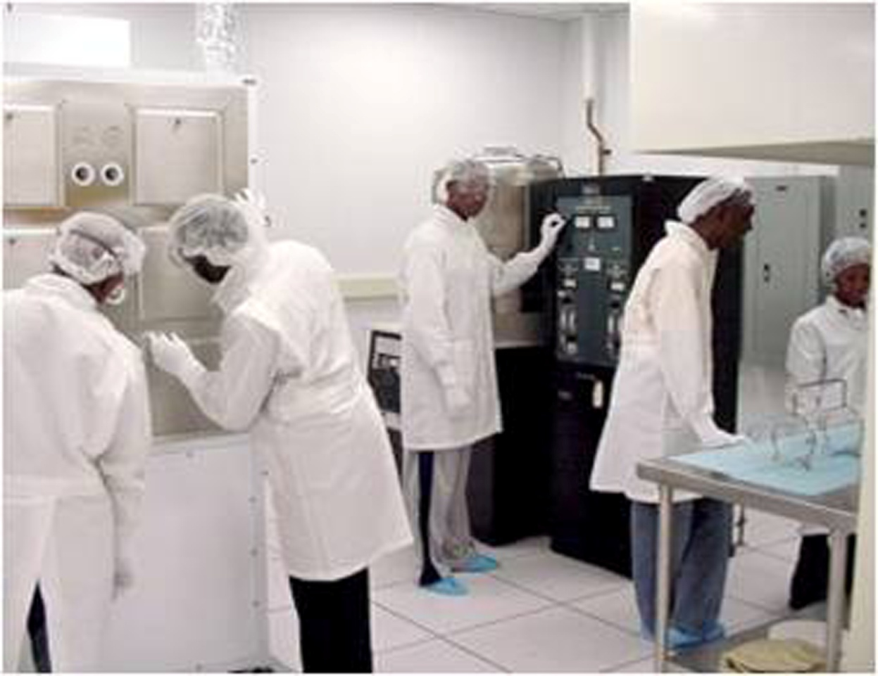
Promote Your Value Proposition
Explain what you can offer to fulfill what the NIH needs.
© 2019 Phenomenal Management Partners
Notes:
When developing your core competencies, be sure to promote your value proposition. Having a clear understanding of your value proposition and the nature of your effort as a business is essential to being competitive in the market. Having a clear understanding of your value proposition is also essential for helping government agencies understand exactly what it is that you can offer them. A value proposition is meant to explain to contract officers and other decision makers what it is that is superior about your products and/or services and encourage them to do business with you.
A value proposition represents the contribution that your university has or can make in the market. Remember, the NIH is not giving money away. They want to buy something. What do you have to offer that would give them an ROI … return on that financial investment?
A value proposition is the reason why the NIH, or any government agency will choose your university as a partner. Most importantly … a value proposition is what the government agency actually values.

Slide 23
Corporate Data
DUNS
Socio-economic certifications: 8(a), HUB Zone, SDVOB, etc.
NAICS Codes
CAGE Code
GSA Schedule Contract Number(s)
Other federal contract vehicles, such as Oasis
© 2019 Phenomenal Management Partners
Notes:
List your business details: such as facilities, if you are strategically locates, say so. Also include the relevant NAICS and Cage codes. Your DUNS number and state certifications, such as SAMS. If you have accreditations, such as ABET, let the government know that by including it on your capability statement. Do you have security clearances? That’s important information.
A quick story.
The AAMU-RISE Foundation is in its second year on a contractor with the NIH’s Jet Propulsion Laboratory. They got the opportunity simply from the capability statement, which included that the university had a clean room. JPL uses a clean room. Students have been to JPL to be trained and more will be going back as the university and the agency are developing an ongoing relationship for the research that is conducted in a clean room. If that information had been omitted from the capability statement, the initial conversation with JPL might have had a different outcome.

Slide 24
Understanding NAICS Codes
What is a NAICS Code?
A NAICS (pronounced NAKES) Code is a classification within the North American Industry Classification System.
The NAICS System was developed for use by Federal Statistical Agencies for the collection, analysis and publication of statistical data related to the US Economy.
© 2019 Phenomenal Management Partners

Slide 25
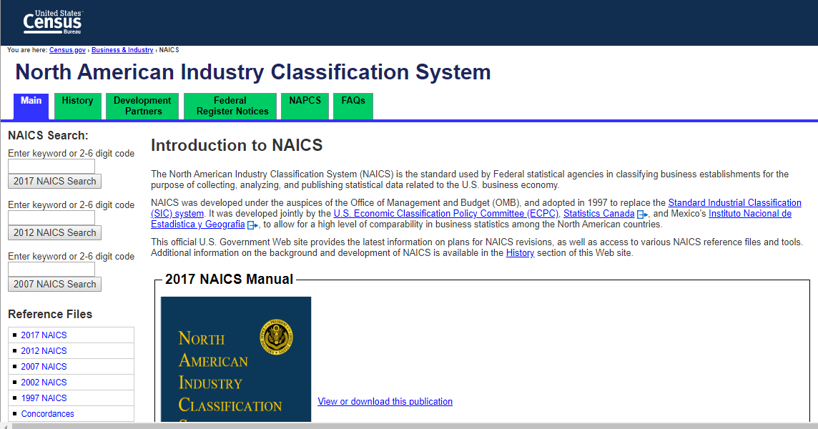
Understanding NAICS Codes
How to determine the correct NAICS code: You can use the search feature at www.census.gov/naics .
© 2019 Phenomenal Management Partners

Slide 26
Top NIH FY2018 NAICS Codes
Research and Development Contracting NAICS Codes
NAICS | Description | Dollars | Contracts
541712 | RESEARCH AND DEVELOPMENT IN THE PHYSICAL, ENGINEERING, AND LIFE SCIENCES (EXCEPT BIOTECHNOLOGY) | $454,741,086.48 | 1,180
541711 | RESEARCH AND DEVELOPMENT IN BIOTECHNOLOGY | $297,091,977.85 | 793
561210 | FACILITIES SUPPORT SERVICES | $279,699,646.75 | 112
541715 | RESEARCH AND DEVELOPMENT IN THE PHYSICAL, ENGINEERING, AND LIFE SCIENCES (EXCEPT NANOTECHNOLOGY AND BIOTECHNOLOGY) | $158,260,772.68 | 183
541714 | RESEARCH AND DEVELOPMENT IN BIOTECHNOLOGY (EXCEPT NANOBIOTECHNOLOGY) | $74,036,261.18 | 112
541990 | ALL OTHER PROFESSIONAL, SCIENTIFIC, AND TECHNICAL SERVICES | $30,567,923.97 | 65
541611 | ADMINISTRATIVE MANAGEMENT AND GENERAL MANAGEMENT CONSULTING SERVICES | $3,025,735.45 | 26
541720 | RESEARCH AND DEVELOPMENT IN THE SOCIAL SCIENCES AND HUMANITIES | $2,146,770.36 | 27
236220 | COMMERCIAL AND INSTITUTIONAL BUILDING CONSTRUCTION | $-33,940.54 | 29
541710 | RESEARCH AND DEVELOPMENT IN THE PHYSICAL, ENGINEERING, AND LIFE SCIENCES | $-1,111,682.88 | 37
© 2019 Phenomenal Management Partners
Notes:
Here are the top NIH NAICS codes for Research and Development contracts. This chart lists the NAICS Codes in descending order based on dollars spent in 2018. What this information tells you is that the NIH spends more on Research and Development in the physical, engineering sciences, except biotechnology than it spends in research and development in the physical, engineering and life sciences. But if your school does not perform engineering R&D, that doesn't mean there is nothing you can sell to the NIH.

Slide 27
Top NIH FY2018 NAICS Codes
Non-Research and Development Contracting NAICS Codes
NAICS | Description | Dollars | Contracts
811219 | Computer Systems Design Services | $518,213,442.92 | 953
334516 | Other Computer Related Services | $307,746,405.51 | 2,505
541990 | All Other Professional Scientific and Technical Services | $234,677,274.11 | 1,092
541519 | Administrative Management and General Management Consulting Services | $195,331,931.29 | 1,141
541611 | Commercial and Institutional Building Construction | $138,639,249.72 | 1,104
325414 | Analytical Laboratory Instrument Manufacturing | $135,030,657.84 | 3,217
236220 | Hotels (Except Casino Hotels) and Motels | $20,925,910.42 | 3,380
721110 | Biological Product (Except Diagnostic) Manufacturing | $17,770,092.32 | 1,032
541512 | Offices of Lawyers | $8,470,438.92 | 1,416
© 2019 Phenomenal Management Partners
Notes:
As you can see from the top NIH NAICS codes for non-research and development contracting, the NIH actually spends the most on computer systems design services.

Slide 28
Differentiators
What is it about your services that make you stand out from the rest? What is it about your people that give you the advantage over your competitors? Why are your services better solutions than the others that are available?
© 2019 Phenomenal Management Partners
Notes:
Doing business with the government is highly competitive. Contractors have the burden of dealing with this competitive market and rising above the other contractors.
Unfortunately, Many HBCUs who are trying to enter the government contracting market do not have a clear value statement detailing what makes them different from a private company or other colleges and universities. A succinct, clear statement that relates to the specific needs of the agency is what will help the procurement and purchasing staff, the program managers and end users understand why they should pick your HBCU.
It is imperative that you explain how your university is unique, different, and distinct from other academic institutions that may be to the government’s needs.
Ask yourself these questions:
How is your university best suited for the needs of this agency?
What is it about your services that make you stand out from the rest?
What is it about your faculty and staff that gives you the competitive advantage?
If you cannot answer these questions in your capability statement, it will be impossible for a decision-maker to make a clear recommendation for contracting with your institution.

Slide 29
Past Performance
Give the contracting officer confidence in your institution’s ability to satisfactorily perform contract requirements.
© 2019 Phenomenal Management Partners
Notes:
Here is where you describe similar work you have previously performed for a government agency.
Past performance comprises a set of specific contracts that you select to demonstrate how well your team has performed on contracts that are similar in size, scope, and complexity to your current bid.

Slide 30
Contact Information
Include a specific person's name, email and phone number.
© 2019 Phenomenal Management Partners
Notes:
Who is going to answer the call? Give this a lot of thought. You may be tempted to list the dean of engineering, or the vice president of sponsored programs as the point of contact. Before you do, take into consideration the responsibilities this person already has on his or her plate. Are they more than likely to be on travel or juggling competing priorities when the agency calls? Will this person truly be able to perform the business development functions that the government is going to expect when the call is answered.
I’m going to be honest for a minute here. That’s part of what makes my company, PMP, valuable to The RISE Foundation. We are not engineers, and we could never do what they do for the NIH. But we do make sure that there is communication … that the NIH has a point of contact …. That the contracting services are managed like a business, even during spring break or winter vacation when the university is closed. My point is, this was not always the case. There were times when calls didn’t get returned in a timely fashion. So don’t put someone’s name on the capability statement unless they truly are capable of being the point of contact.
On the capability statement, show the contact information, including web site and a specific person's name, email and phone number.
Now … here is a shameless plug for my company … If your HBCU doesn’t have the bandwith to handle the business development functions of contracting with the government, talk to me. We can be the liaison to allow you to do what you do best and we’ll handle the rest.

Slide 31
Capability Statement Format
Sample from HHS website
© 2019 Phenomenal Management Partners
Notes:
So I’ve talked about the content. Now, lets go over what a capability statement should look like. A Capability Statement should be very brief (only 1 or 2 pages) and to the point. No long paragraphs. I have a couple of samples here, if anyone wants to look at them. This is the one-page version that the AAMU-RISE Foundation uses, along with their brochure format. The brochure is more generic, and does not include past performance because it often is distributed in a full literature kit which contains more details of specific projects and applications, or during meetings when a capabilities PowerPoint briefing is presented containing the past performance details. I also have a sample here from a company that puts its capability statement on a laminated card, which is a good format for distributing at conferences.
Whatever format you decide to use, it is important that the document be visually interesting and have similar graphic elements to your university's logo and brand. I recommend that you create the Capability Statements in Word or Publisher.
Save and distribute as a PDF, not in the program format because many federal agencies block Word and document formats because they may harbor viruses; however, a PDF file is much safer, it is usually smaller and stays visually consistent when emailed. Word, PowerPoint or other format. Save the document with your school’s name in the file name.

Slide 32
Customize the Document
For the Specific NIH Center
Clinical Center (CC)
National Cancer Institute (NCI)
National Heart, Lung, And Blood Institute (NHLBI)
National Institute Of Allergy And Infectious Diseases (NIAID)
National Institute Of Child Health And Human Development (NICHD)
National Institute On Drug Abuse (NIDA)
National Institute Of Environmental Health Sciences (NIEHS)
National Library Of Medicine (NLM)
Office Of Logistics And Acquisition Operation (OLAO)
Office Of Research Facilities Development & Operations (ORF)
© 2019 Phenomenal Management Partners
Notes:
Earlier, I mentioned that I would talk about customizing the capability statement. This would really be important if you are planning to market your university to various the NIH Centers. Remember that each the NIH center has its own mission, its own needs and requirements.

Slide 33
Capability Statement Tips
Always keep your Capability Statement current.
Capability Statements must be tailored to your audience.
Be very brief, but highlight your value proposition.
© 2019 Phenomenal Management Partners
Notes:
Here are some other tips:
Always Keep Your Capabilities Statement Current
And, as I said before, be brief but highlight your value proposition

Slide 34
Questions?
Send them to: NIHSmallBusiness@mail.nih.gov
Notes:
Any Questions? If you think of something after this workshop has ended, you can send questions to the address here on the slide. This the email address for Rachel Ramirez, Program Analyst at the NIH Small Business Program Office.

